Slide 1
StudyBuddy!
Tony
Jaee
Trayvon

Slide 2
Handshake Data
Client
Server
String: 05:STUDYBUDDY:1.0:01
String: 05:StudyBuddy:1.0:01
Server responds with a String Either Welcome or Goodbye.

Slide 3
Authentication Thread/Account Creation Data
Client - Input
Server - Output
Strings
fName, lName, email, pass1, pass2
Int
0 : User Accepted
1 : User Already Exists
2 : Invalid Password
3 : Password Mismatch

Slide 4
Authentication Thread/Login Data
Client - Input
Server - Output
Strings
email, pass
0 : Successful login
1 : Login Before Handshake
2 : User Not Found
3 : Incorrect Pass
4 : Too Many Bad Login Attempts

Slide 5
Session Thread Data\Linked List
Member Node
Online Client List
Strings - email, fname, lname, ip Int - status Object output - objOut Object Input - objIn Session - session
Get User Info
Insert User
Remove User

Slide 6
Session Thread Data\Chat Rooms
Chat Room Class
Chat Rooms Class
Strings - profName, profEmail, className, meetTime Int - onlineUsers
String Array - users String Array - chats String Array - files
Chat Room Array - which holds all chat rooms.
addMessage
addImage

Slide 7
Data Models : Student
sID | sEmail | sPass | fName | lName
123 | jae@uncg.edu | ******* | Jaee | Carr
456 | tray@uncg.edu | ********** | Tray | Mickey
789 | tony@uncg.edu | ***** | Tony | Ratcliff

Slide 8
Data Models : Classes
cID | profName | profEmail
82352 | Mohanty | mrm@uncg.edu
87251 | Tate | drtate@uncg.edu
88307 | Greene | profgreene@unc.edu

Slide 9
Data Models : Offline Messages
RsID | SsID | offMsg | timeStp
123 | 456 | “Notes!!!!!!!!!!!!!” | 04:04
789 | 456 | “Nah Fam” | 15:34

Slide 10
Data Models : Attendance
cID | sID | profName | profEmail | timeStp
82352 | 123 | Mohanty | mrm@uncg.edu | 12:15
87251 | 456 | Tate | drtate@uncg.edu | 09:50
88307 | 789 | Greene | profgreene@unc.edu | 15:15

Slide 11
Data Model: Session List
Session is a doubly linked list representing everyone online
Student 1
Student 2
Student 3
Student 4
Student Logs On

Slide 12
Data Model: Session List
Student 1
Student 2
Student 3
Student 4
Student Logs On
New Student’s session is added to the end of list

Slide 13
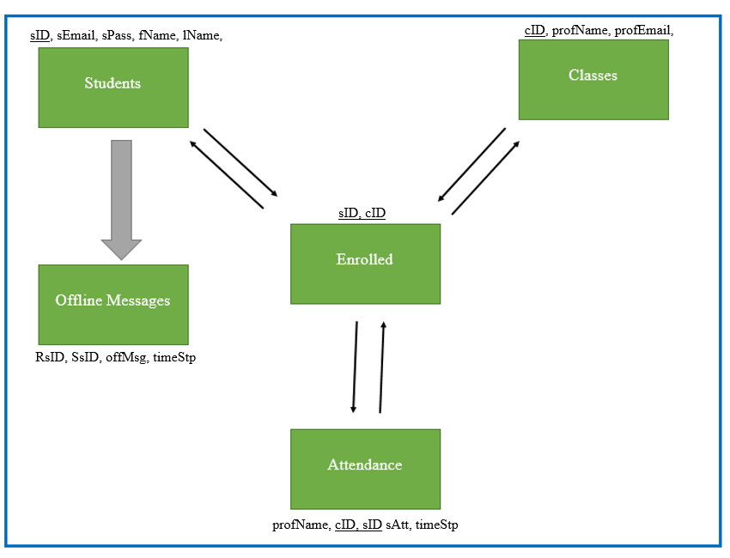
Entity-Relationship Model

Slide 14
System/Algorithm Analysis - Standard Operations
Most algorithms will have a time and space complexity of BigO(1).
Login
Registration
Create Node
Insert Session

Slide 15
System/Algorithm Analysis - Linked List
Search Operations - BigO(n)
Find session
Remove Session

Slide 16
System/Algorithm Analysis - Data Base Queries
Initial Setup of Tables - Bigo(n) (for each table)
Attendance
Classes
Students
Offline Messages
Enrolled
x

Slide 17
System/Algorithm Analysis - Data Base Queries
Database Queries - BigO(logn) for each query
Session
Attendance
Classmates
Student Classes

